Slide 1

Sorting algorithm In C Sharp.

Slide 2

Sorting Types

Slide 3
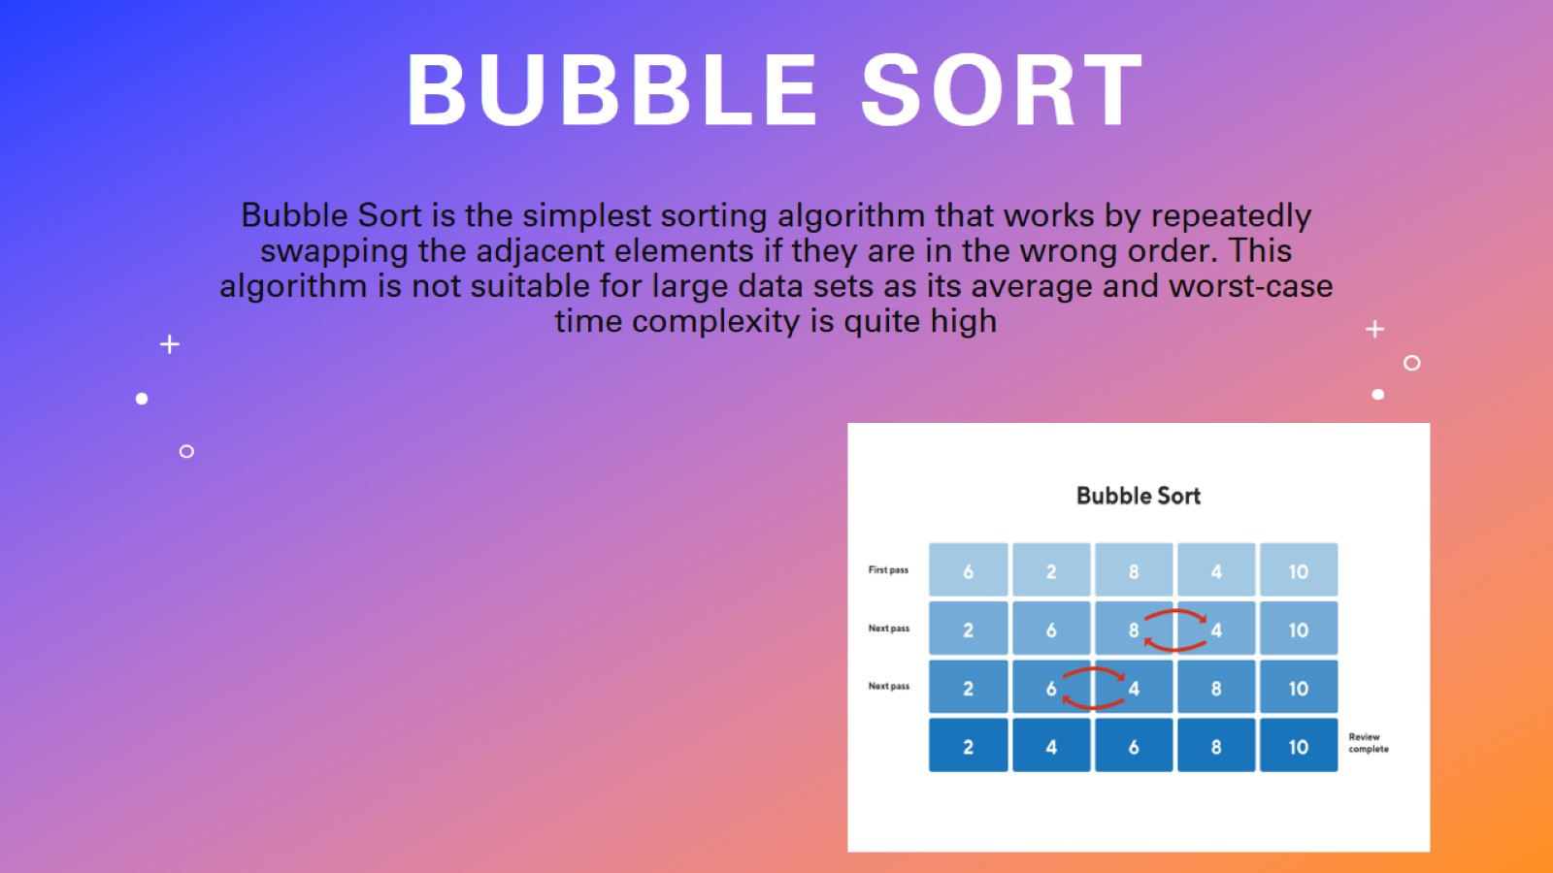
Bubble Sort

Slide 4
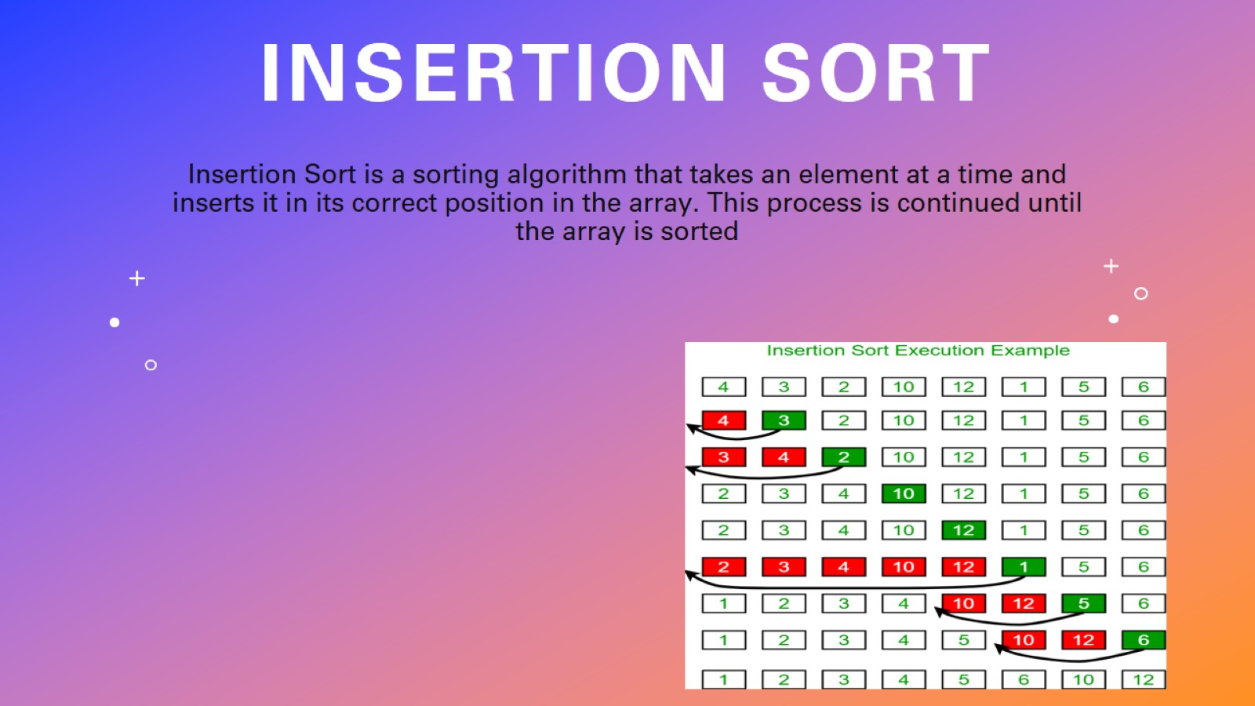
insertion Sort

Slide 5
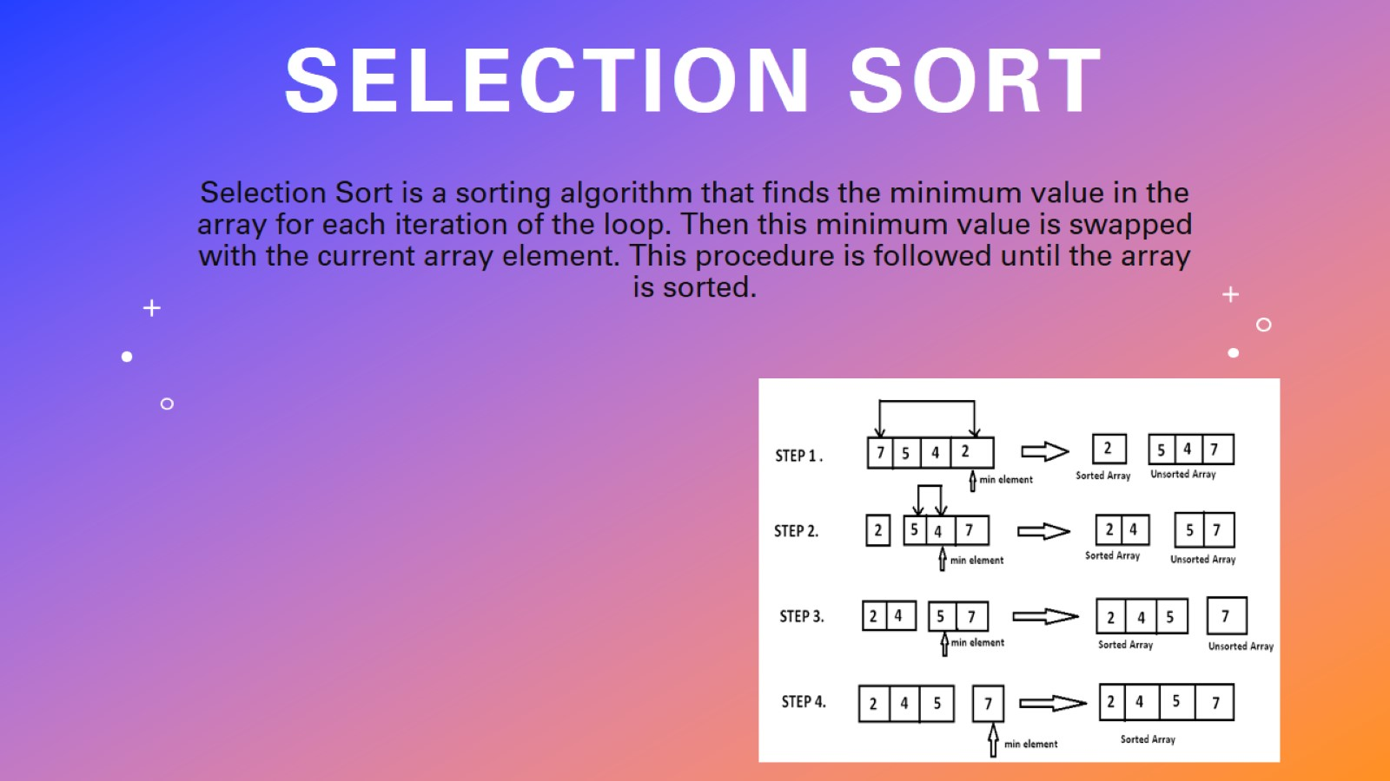
Selection Sort

Slide 6
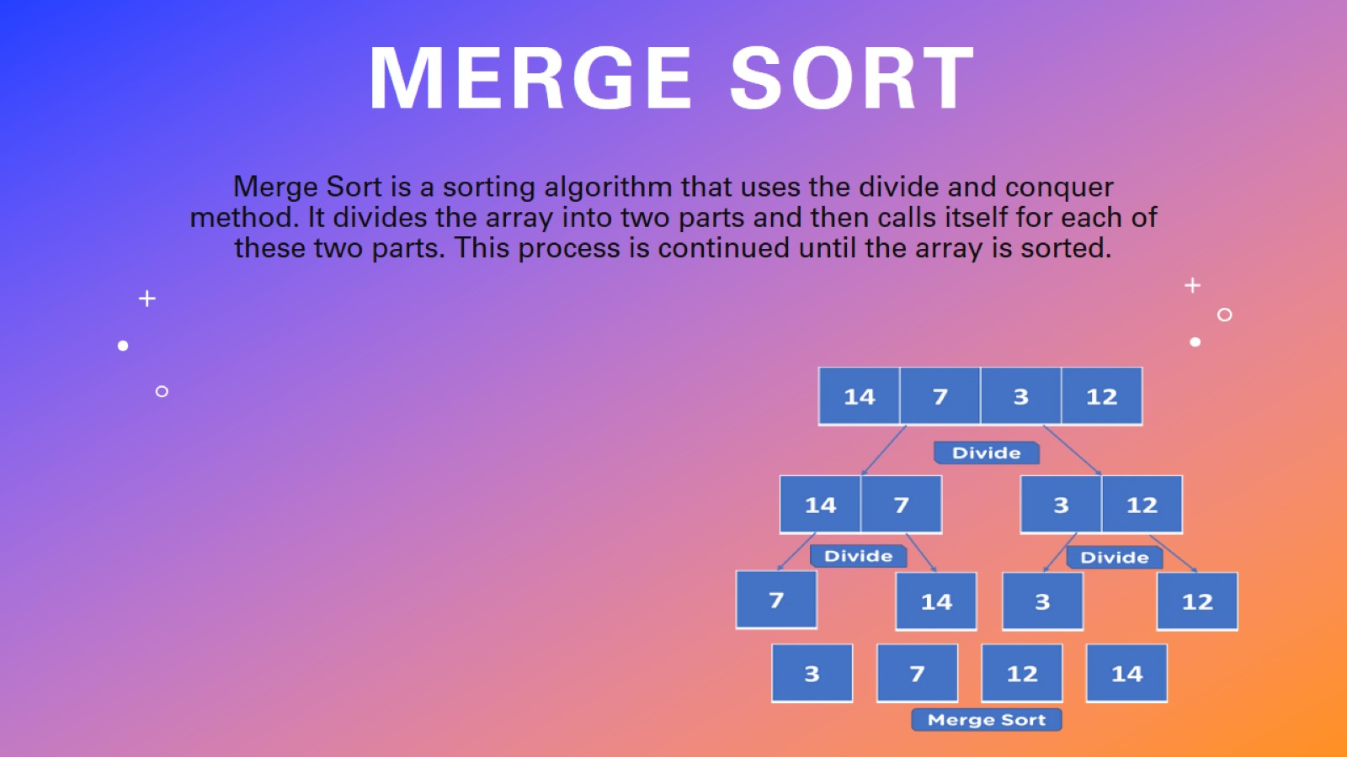
Merge Sort

Slide 7
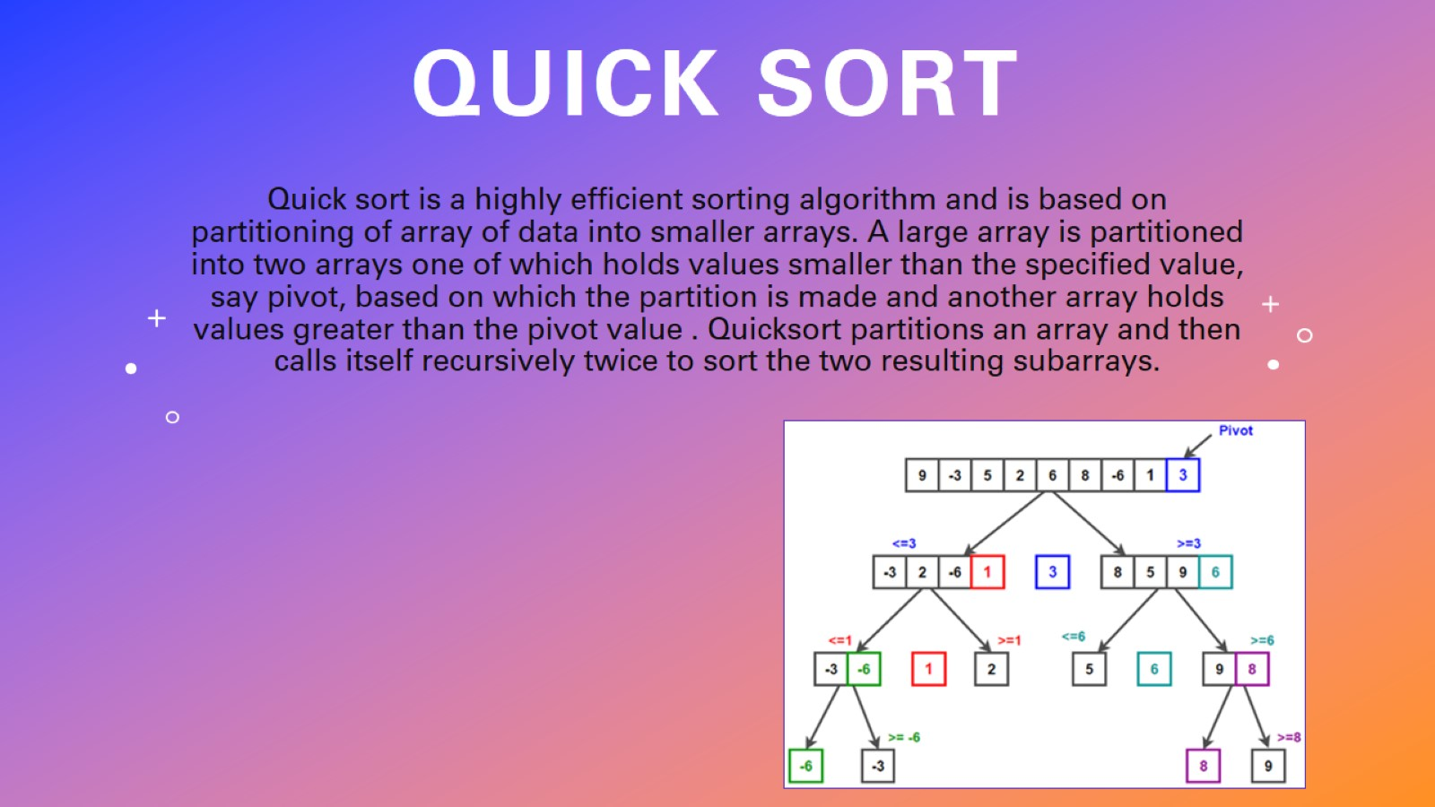
quick Sort

Slide 8
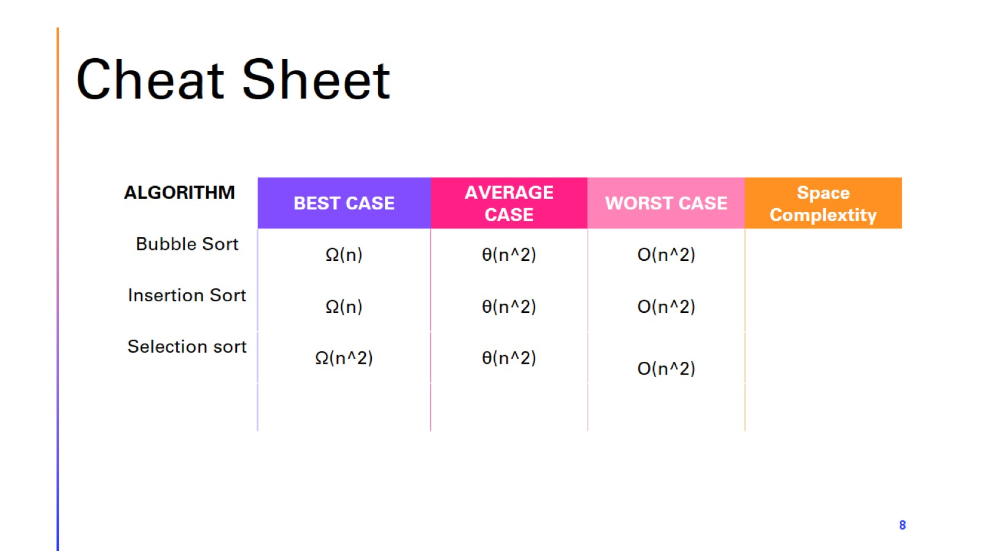
Cheat Sheet

Slide 9

Thank you

